Slide 1
Spam, Phishing, Routing & Naming Security COS 432: Information Security
Nick Feamster

Slide 2


Why Network Security?
Availability (recall CIA properties)
Metadata can be revealing
Application-layer security (HTTPS etc.) not yet universal
?
Alice
Network
Bob
Notes:
So far we’ve mostly assumed the network is an amorphous blob. Everything we’ve seen w.r.t. application-layer security assumes that the network might be malicious, so from that perspective it’s not strictly necessary to worry about network security. But in practice it’s still important, for at least 3 reasons listed on the slide.
Metadata = who’s talking to whom, when, how much data, etc. Recall the debates about NSA collecting metadata.

Slide 3
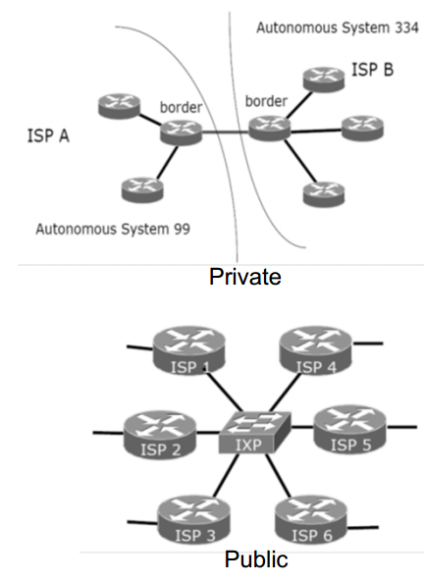
Interconnection
Internet is a network of networks
Each network is an “autonomous system” (AS)
such as ISPs
ASes connect together at exchange points
About 60,000 AS numbers assigned
Notes:
Image credit: http://www.cs.unc.edu/~reiter/courses/fall2013/notes/BGPSEC.pdf
IXP = Internet Exchange Point

Slide 4
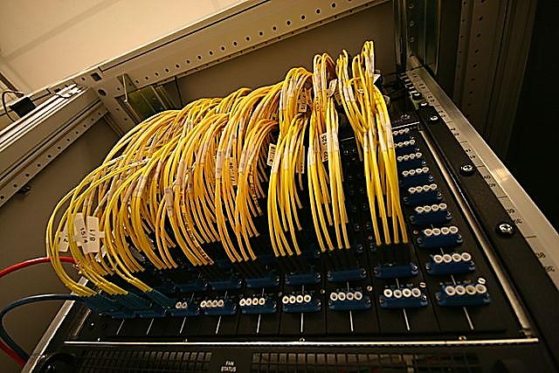
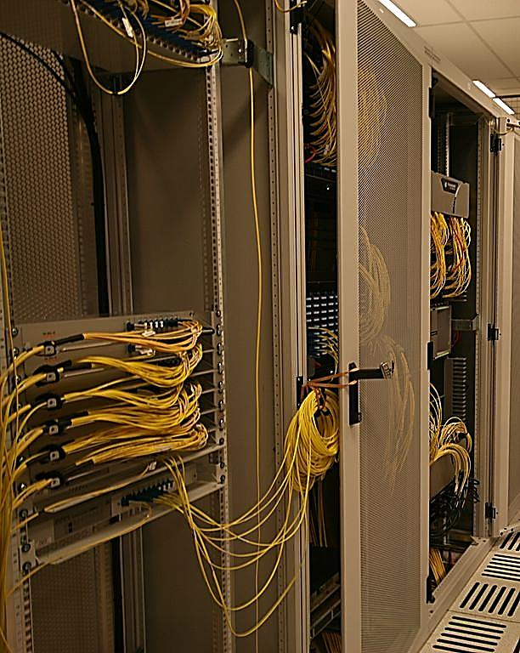
Amsterdam Internet Exchange
Nonprofit
One of the world’s largest
About 4 Tbps of bandwidth
About 400 members
Notes:
Images: Wikipedia
Members = AS’s

Slide 5
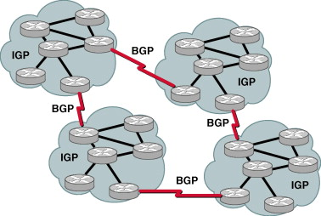
Internet Routing: Based on BGP
BGP is the protocol for different AS’s to exchange routing info
Not the actual routing protocol
(that’s IP)
Let’s study at Shortest Path Routing instead of BGP
Nice illustration of attacks
Similar issues apply in BGP
Notes:
http://ciscorouterswitch.over-blog.com/article-bgp-protocol-is-essential-in-your-ip-network-115059468.html

Slide 6
Shortest Path Routing
Routers talk to each other
Exchange topology & cost info
Each router calculates shortest path to destination
Calculate next hop based on that
Forwards packet to next hop
Routers can lie about paths, costs
Notes:
Cost: could be combination of latency, actual dollar cost, etc. We will think of it as a distance for computing shortest paths.

Slide 7
BGP Insecurity
“IP Prefix hijacking” attack
Similar to the ones above
Very easy to execute
So easy, in fact, that they regularly happen due to…misconfiguration!

Slide 8
Great Moments in Internet History: Pakistan Attempts to Censor YouTube (2008)
Goal: announce route to YouTube's IP block to Pakistani users so that they can be redirected to censor page
Misconfiguration: announced to whole world
Other routers happily propagated this info
Result: YouTube censored worldwide for several hours
Notes:
Featuring totally gratuitous pic of Pakstani Imam that has nothing to do with anything

Slide 9
China “hijacks Internet”
Typical hijacking due to accidental misconfiguration
What was different here?
Announced routes to (random-ish) 15% of Internet
About 50,000 IP blocks
AS big enough that it didn’t get crushed under load
Actually forwarded the traffic, didn’t cause much delays
Users didn’t notice anything during the event
Most affected traffic was local to China or international
Some advertised IP blocks were inevitably were from other countries (incl. USG websites, which media picked up on)
Notes:
Back to our story
Chinese AS was misconfigured, announced routes to 37,000 IP blocks which constituted a random-ish 15% fraction of the Internet
A packet from say Princeton to New York is not going to be affected by these fake routes, because the correct path is the shortest path anyway
But if a packet is going from New York to London, there’s a good chance it will get routed through China if it flows through an Internet Exchange Point (IXP) where the Chinese AS is also present.
Detailed analysis http://www.renesys.com/2010/11/chinas-18-minute-mystery/

Slide 10
Spam (and Spam Filtering)

Slide 11
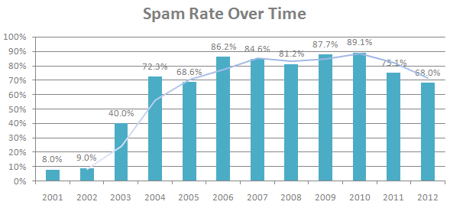
Spam: A Persistent Security Threat
70-90% of all email traffic is spam
(Sources: Symantec 2010, MAAWG 2011, Symantec 2013)

Slide 12


Negative Effects of Spam
Sale of illicit merchandise
e.g., pharmaceuticals, replica luxury goods
Social cost
e.g., wasted time of users
$1 spammers’ revenue
≈ $100 cost to society *
Carrier of other attacks
e.g., phishing, spyware, trojans
Illegal online pharmacy
Fake website with bogus survey
*Rao et al. The Economics of Spam.
Journal of Economic Perspectives, Volume 26, Number 3, 2012

Slide 13
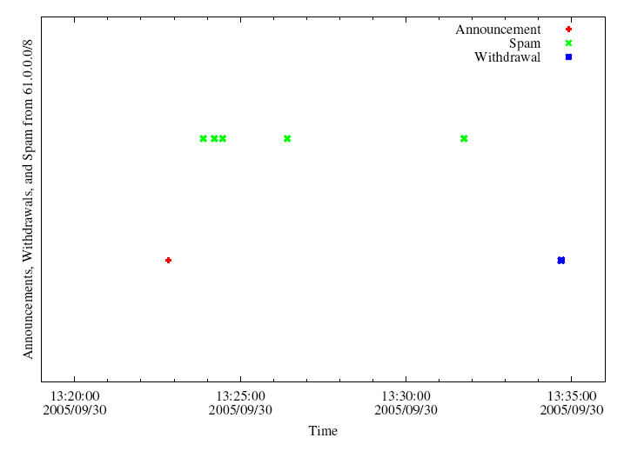
Spam Meets Routing Security!
Hijack IP address space using BGP
Send spam
Withdraw IP address
A small club of persistent players appears to be using this technique.
Common short-lived prefixes and ASes
~ 10 minutes
61.0.0.0/8 4678
66.0.0.0/8 21562
82.0.0.0/8 8717
Somewhere between 1-10% of all spam (some clearly intentional, others “flapping”)

Slide 14
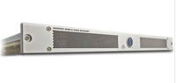
Approach: Filter
Prevent unwanted traffic from reaching a user’s inbox by distinguishing spam from ham
Question: What features best differentiate spam from legitimate mail?
Content-based filtering: What is in the mail?
IP address of sender: Who is the sender?
Behavioral features: How the mail is sent?

Slide 15

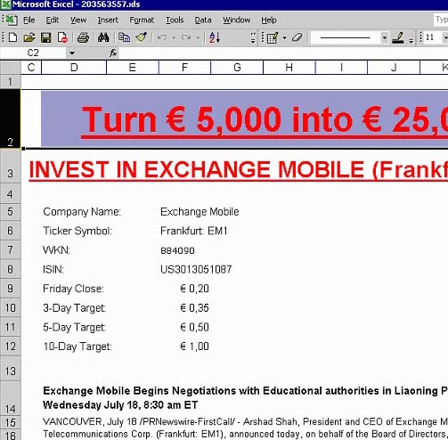

Approach #1: Content Filters
PDFs
Excel sheets
Images
...even mp3s!

Slide 16
Content Filtering: More Problems
Customized emails are easy to generate: Content-based filters need fuzzy hashes over content, etc.
Low cost to evasion: Spammers can easily alter features of an email’s content can be easily adjusted and changed
High cost to filter maintainers: Filters must be continually updated as content-changing techniques become more sophisticated

Slide 17
Approach #2: IP Addresses
Received: from mail-ew0-f217.google.com (mail-ew0-f217.google.com [209.85.219.217])
by mail.gtnoise.net (Postfix) with ESMTP id 2A6EBC94A1
for <feamster@gtnoise.net>; Fri, 23 Oct 2009 10:08:24 -0400 (EDT)
Problem: IP addresses are ephemeral
Every day, 10% of senders are from previously unseen IP addresses
Possible causes
Dynamic addressing
New infections

Slide 18
Network-Level Scam Defenses
Scammers host Web sites on dynamic scam hosting infrastructure
Use DNS to redirect users to different sites when the location of the sites move
State of the art: URL Blacklisting
Our approach: Blacklist based on network-level fingerprints
Konte et al., “Dynamics of Online Scam Hosting Infrastructure”, PAM 2009

Slide 19
Filtering Based on Network Behavior
Filter email based on how it is sent, in addition to simply what is sent.
Network-level properties: lightweight, less malleable
Network/geographic location of sender and receiver
Set of target recipients
Hosting or upstream ISP (AS number)
Membership in a botnet (spammer, hosting infrastructure)

Slide 20
Why Network-Level Features?
Lightweight: Don’t require inspecting details of packet streams
Can be done at high speeds
Can be done in the middle of the network
Less Malleable: Perhaps more difficult to change some network-level features than message contents

Slide 21
Set of Network-Level Features
Single-Packet
Geodesic distance
Distance to k nearest senders
Time of day
AS of sender’s IP
Status of email service ports
Single-Message
Number of recipients
Length of message
Aggregate (Multiple Message/Recipient)

Slide 22
Important Network-Level Features

Slide 23
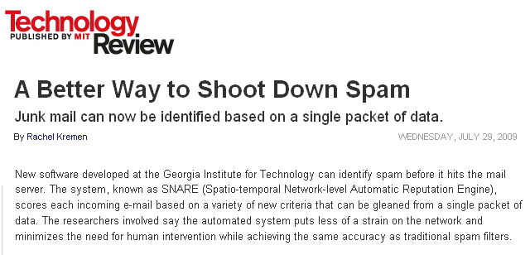
Putting it Together
Email arrival
Whitelisting
Greylisting
Retraining

Slide 24
Phishing, Online Scams, and Bulletproof Hosting

Slide 25

Phishing and Online Scams

Slide 26
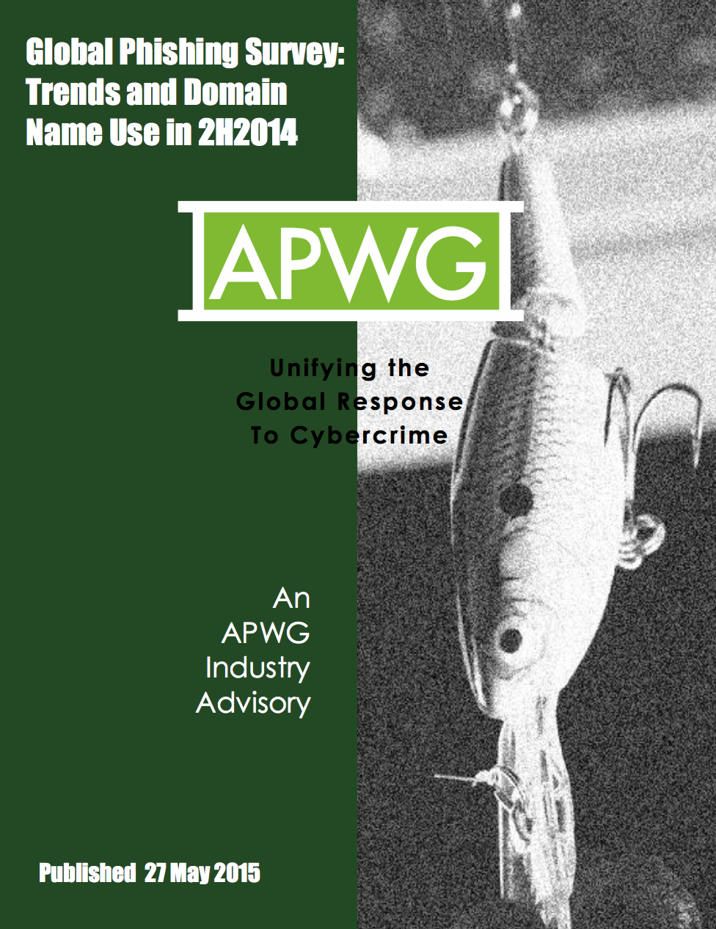

Slide 27
Some Statistics (2H 2014)
There were at least 123,972 unique phishing attacks worldwide.
The attacks occurred on 95,321 unique domain names. This is the most we have ever recorded in a half-year period.
We identified 27,253 domain names that we believe were registered maliciously, by phishers. This is an all-time high.
Seventy-five percent of the malicious domain registrations were in just five TLDs: .COM, .TK, .PW, .CF, and .NET.
Phishing occurred in 272 top-level domains (TLDs). Fifty-six of them were new top- level domains.
Only 1.9 percent of all domain names that were used for phishing contained a brand name or variation thereof.

Slide 28
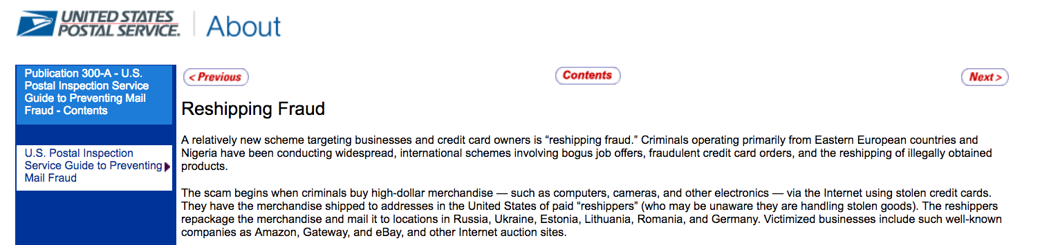
Reasons for Phishing Attacks
Credit card number theft
Credential theft (shared passwords across sites)
Reshipping fraud
Notes:
A relatively new scheme targeting businesses and credit card owners is “reshipping fraud.” Criminals operating primarily from Eastern European countries and Nigeria have been conducting widespread, international schemes involving bogus job offers, fraudulent credit card orders, and the reshipping of illegally obtained products.
The scam begins when criminals buy high-dollar merchandise — such as computers, cameras, and other electronics — via the Internet using stolen credit cards. They have the merchandise shipped to addresses in the United States of paid “reshippers” (who may be unaware they are handling stolen goods). The reshippers repackage the merchandise and mail it to locations in Russia, Ukraine, Estonia, Lithuania, Romania, and Germany. Victimized businesses include such well-known companies as Amazon, Gateway, and eBay, and other Internet auction sites.

Slide 29
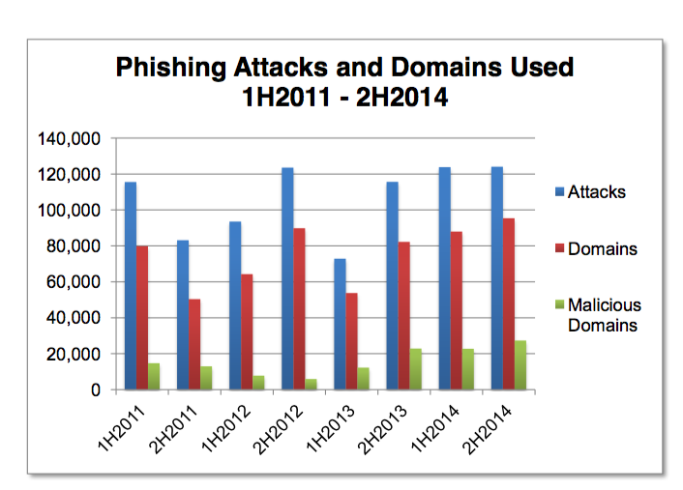
Phishing Attacks vs. Malicious Domains

Slide 30
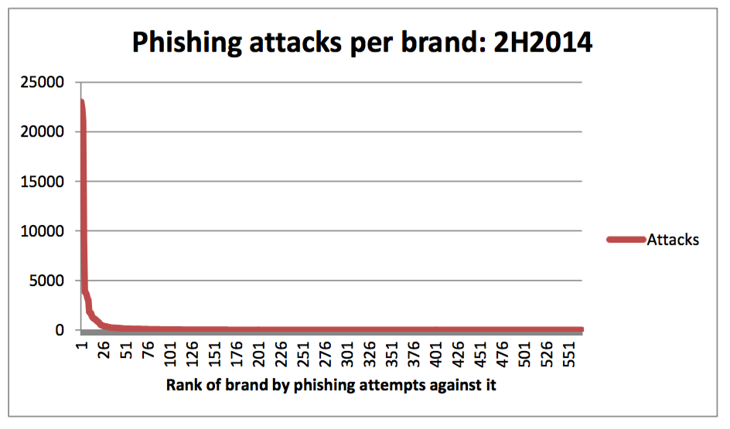
Phishing Attacks per Brand
The top 10 targets accounted for over three quarters of all attacks. Phishers continued to attack Apple, PayPal, and Taobao.com heavily. Each of these three e-commerce giants suffered over 20,000 phishing attacks against their respective services and brands.
Together, these top three were the targets of nearly 54 percent of the world’s phishing attacks.

Slide 31
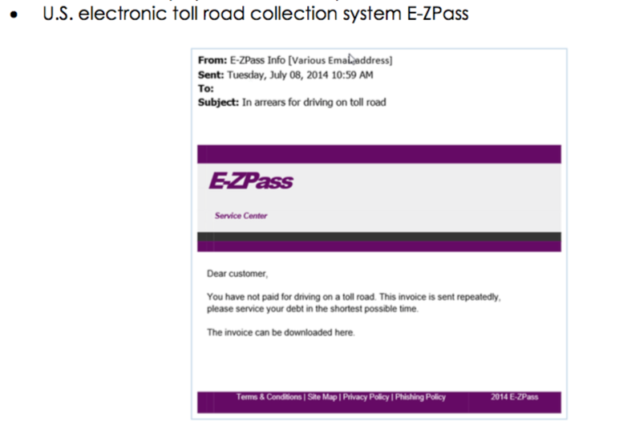

Slide 32
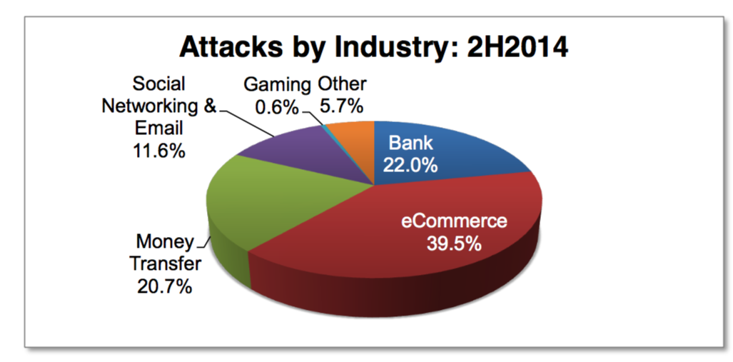

Slide 33
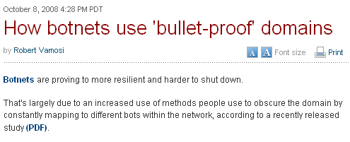
Online Scams
Often advertised in spam
URLs point to various point-of-sale sites
These scams continue to be a menace
As of August 2007, one in every 87 emails constituted a phishing attack
Scams often hosted on bullet-proof domains
Problem: Study the dynamics of online scams, as seen at a large spam sinkhole

Slide 34
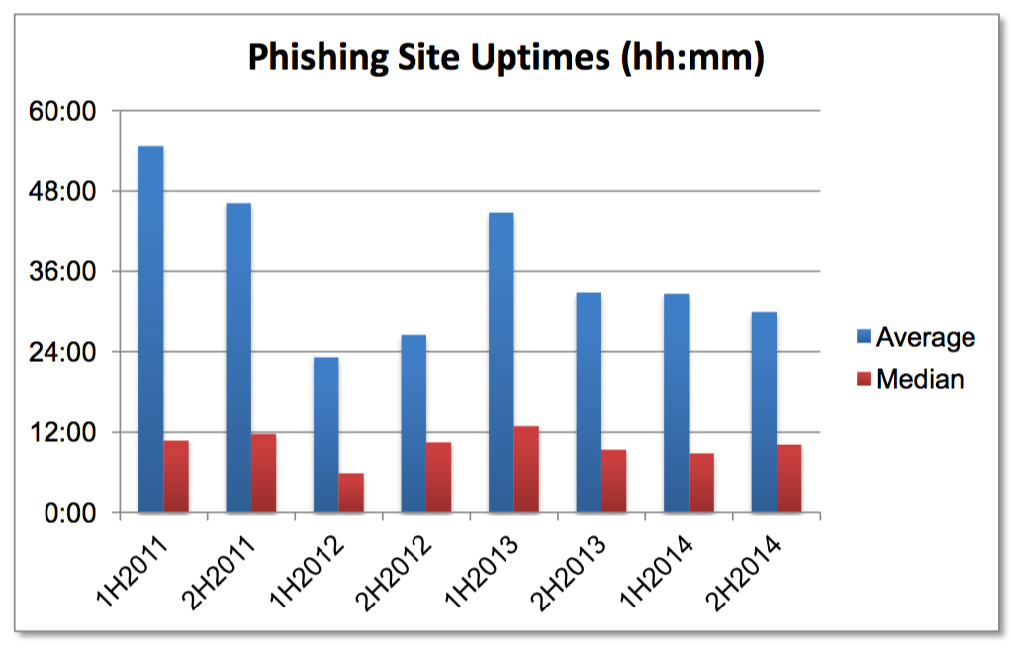
Phishing Site Uptime: Often Short!

Slide 35
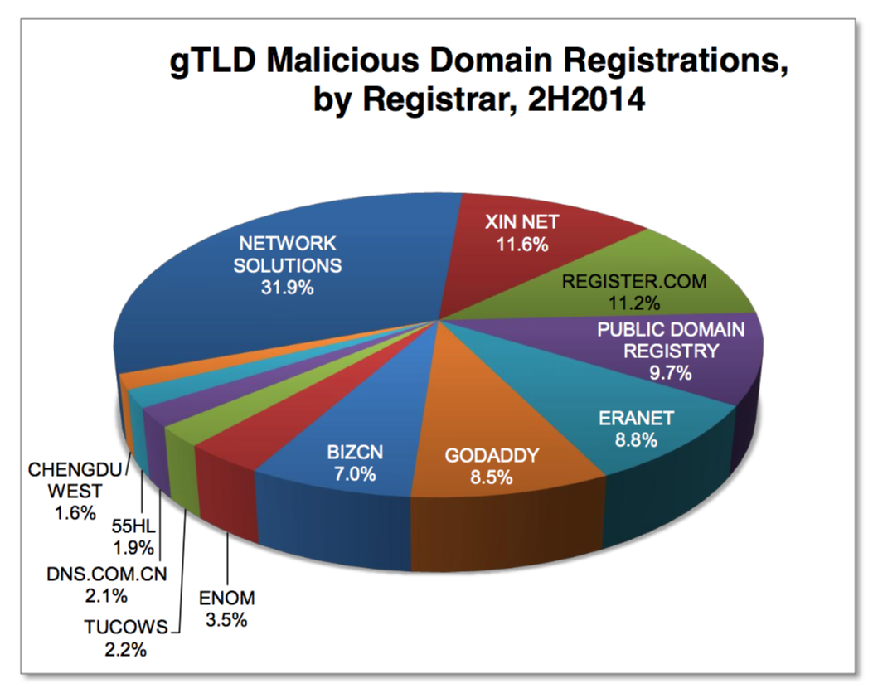
Phishing Attacks by Registrar

Slide 36
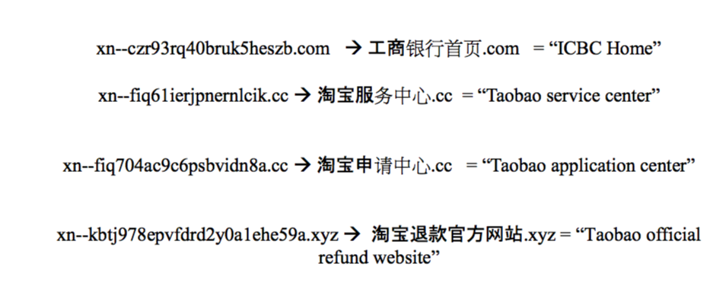
IDNs and Phishing
Notes:
IDNs are domain names that contain one or more non-ASCII characters. Such domain names can contain letters with diacritical marks such as ǎ and ü, or be composed of characters from non-Latin scripts such as Arabic, Chinese, Cyrillic, or Hindi. Over the past eight years, IDNs have been available at the second and third levels in many domain name registries, with the majority registered in Asia. IDN TLDs allow the entire domain name to be in non-Latin characters, including the TLD extension.
The IDN homographic attack is a means by which a phisher seeks to deceive Internet users by exploiting the fact that characters in different language scripts may be nearly (or wholly) indistinguishable, thereby allowing the phisher to spoof a brand name. From January 2007 to June 2014 we found only nine true homographic phishing attacks.

Slide 37
Online Scam Hosting is Dynamic
The sites pointed to by a URL that is received in an email message may point to different sites
Maintains agility as sites are shut down, blacklisted, etc.
One mechanism for hosting sites: fast flux

Slide 38
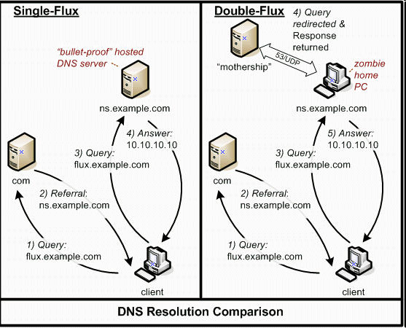
Mechanism for Dynamics: “Fast Flux”
Source: HoneyNet Project

Slide 39
Malicious Domain Names: Abuse and Detection

Slide 40

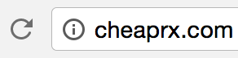


Domain Abuse in Practice
Registration
Use
Detection
Detection Latency
Detection latency can be weeks for blacklists

Slide 41
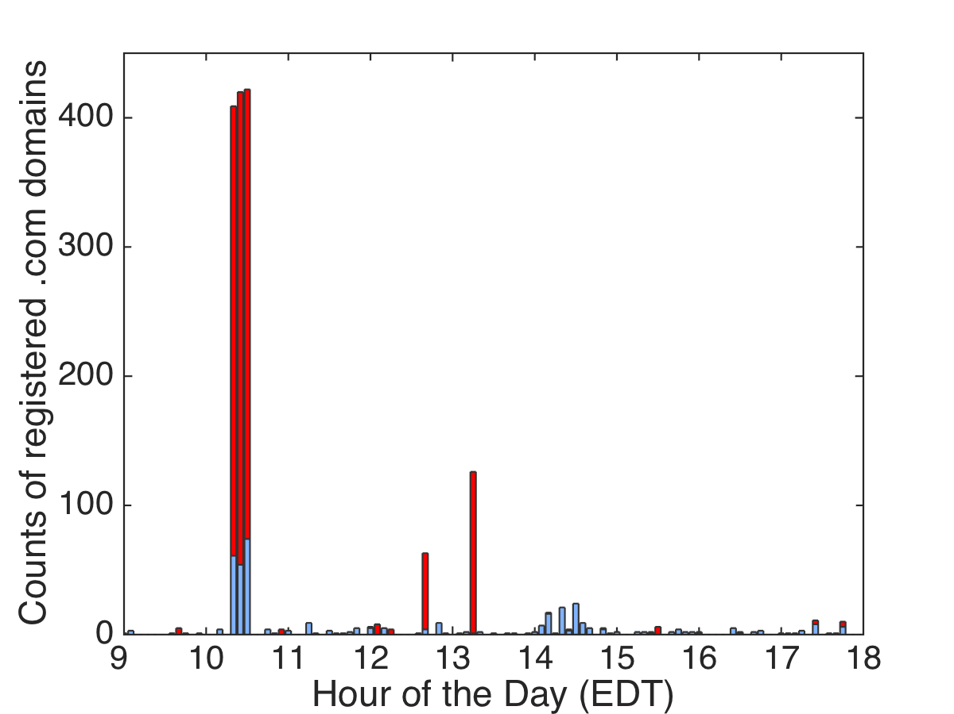
Batch Registration
Malicious
Benign

Slide 42
Domain Reuse
Some spammers favor used domains
Malicious
Benign

Slide 43
Domain Reuse
Some spammers favor used domains
Registration batches share reuse properties
Time Range | New Domains* | Re-used Domains*
10:15-10:20 | 0 | 348
10:20-10:25 | 0 | 366
10:25-10:30 | 0 | 348
12:35-12:40 | 52 | 7
13:10-13:15 | 118 | 7
*Benign domains omitted

Slide 44
Common Substrings
Registration batches contain repeated strings
Repeated strings reflect campaign themes
Registration Time Range: 13:10 – 13:15
financilsart.com financilss.com financilsssky.com financilsspro.com financilssart.com financilssky.com | asklenderhome.com askhomelendersnow.com asklendershome.com askhomelender.com askhomelenders.com asklendertoday.com

Slide 45
Registration-based Features
Domain profile features
Available at WHOIS
e.g., registrar, nameservers, lexical patterns
Life cycle features
Available at third-party services (like DomainTools)
e.g., life-cycle type, dormancy period for re-registration, previous registrar
Batch correlation features
Available at registries/registrars
e.g., probability of registration spike, life-cycle proportion in the same batch

Slide 46
Detecting Malicious Domain Names
Prior knowledge
Training
mode
Feature extraction
Learning module
Statistical classifier
Reputation score
Operation
mode

Slide 47
Supervised Learning: CPM
Convex polytope machine (CPM)
High accuracy
Train models fast
SVM
CPM
X
X
X
X
X
X
X
X
X
X
X
X

Slide 48

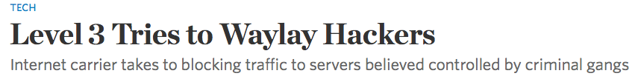
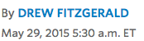
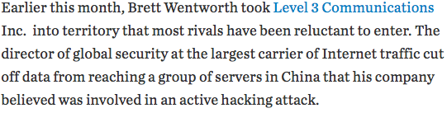
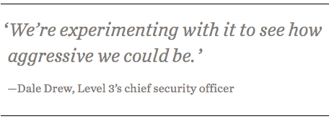
ISP blocks traffic to servers likely operated by cybercriminals
‘We’re experimenting with it to see how aggressive we could be.’
-Dale Drew, Level 3’s chief security officer

Slide 49


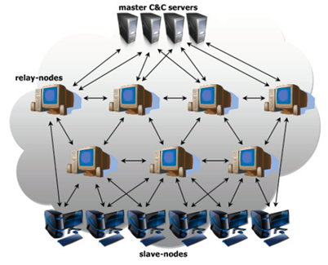


Bulletproof Hosting ASes
Primarily engaged in cybercrime. Provide freedom and resources for cybercriminals to operate
Fully controlled and managed by cybercriminals
Different from abused but legitimate ASes, e.g. a cybercriminal rents a machine for a short period of time and then releases back the machine

Slide 50
Bulletproof Hosting ASes
Shutdowns:
McColo, Atrivo/Intercage
phishing
C & C botnets
Scam hosting
malware
Provide freedom and resources for cybercriminals to operate (hosting illegal and criminal content, C&C servers)
Fully controlled and managed by cybercriminals
Different from abused legitimate ASes (eg GoDaddy)

Slide 51
Traffic Monitoring
Examine concentration
/persistence
of badness
AS
Monitor traffic
Badness
score
Example current AS reputation systems: BGP Ranking, Hostexploit, FIRE
Either collect the above directly or rely on third parties

Slide 52
Problems with Network Monitoring
Need for lots of vantage points. Impossible to monitor data plane activity globally
High false positives. Reports include legit but abused ASes
Difficult to use these reports for eg traffic blocking
Usually the attacks are already under the way
Example Hostexploit Report (03/2014)
1. Landis Holdings
2. NewDream
3. Ecatel
7. Cloudflare
10. GoDaddy
24. SoftLayer Technologies
38. Google

Slide 53
New Approach: Monitor Routes
Motivation: Our previous work on rewiring behavior of bulletproof hosting ASes.
Re-wiring Activity of Malicious Networks M. Konte, N. Feamster Passive and Active Measurement Conference 2012 (PAM)
Examine closer and understand the behavior of bulletproof hosting ASes: rewiring and routing dynamics

Slide 54
New Approach: Monitor Routes
Easy to get vantage points.
Can monitor an AS before the attack takes place.
False positives. Legitimate but abused are flagged as legitimate.
Use of AS reputation in practice.
Example Hostexploit Report (03/2014)
1. Landis Holdings
2. NewDream
3. Ecatel
7. Cloudflare
10. GoDaddy
24. SoftLayer Technologies
38. Google

Slide 55
Why Monitor the Control Plane
AS8342
RTCOMM
AS29632
NASSIST
AS25189
NLINE
AS5577
ROOT
AS48172
OVERSUN-MERCURY
AS28917
FIORD
AS44050
PIN
AS29632
NASSIST
AS25478
IHOME
AS12993
DEAC
Legitimate
AS12383
PROFITLAN
AS50215
TROYAK
AS31366
SMALLSHOP
Masking
AS44051
YA
AS8287
TABA
Bulletproof
AS50369
VISHCLUB
AS42229
MARIAM
AS50390
SMILA
AS12604
CITYGAME
AS49934
VVPN
AS47560
VESTEH
AS44107
PROM-
BUDDETAL
AS47821
BOGONET

Slide 56
Case Study: Malicious AS Troyak
AS25478
IHOME
AS29632
NASSIST
AS5577
ROOT
AS48172
OVERSUN-
MERCURY
AS50215
TROYAK
AS44051
YA
AS50215
TROYAK
AS12383
PROFITLAN
AS12383
PROFITLAN
AS31366
SMALLSHOP
AS8287
TABA
AS31366
SMALLSHOP
AS50390
SMILA
AS42229
MARIAM
2010.04.01
2010.02.01
Connectivity snapshots taken 3 months apart

Slide 57
Features of Bulletproof Hosting
Rewiring Changes | e.g. change of providers | Link stability
BGP Routing Dynamics | e.g. interarrival time of prefix advertisements | IP space fragmentation
IP Space Fragmentation & Churn | e.g. change of advertised prefixes | Prefix reachability

Slide 58
Rewiring Changes
Snapshots taken 3 months apart
Malicious ASes tend to change connectivity more aggressively than legit ASes

Slide 59
Example feature: Upstream link stability
Measure how many snapshots it links with each provider
CDF
Monitor the last x snapshots
AS50215
TROYAK
Collect
all providers
Capture the distribution
Upstream link stability is represented by three features.

Slide 60
BGP Routing Dynamics
Advertise
52.34.21.0/24
Withdraw
52.34.21.0/24
Malicious activity
Malicious AS
Malicious AS
Malicious AS
Malicious AS routing dynamics are driven by illicit operations e.g. short-lived announcements to perform malicious actions
In contrast legit AS dynamics are driven by policy changes, traffic engineering decisions

Slide 61
Fragmentation and churn of advertised prefixes
109.196.143/24
62.123.14/24
109.196.141/24
85.124.23/16
42.10.14/23
131.124.14/23
92.112.112/23
52.34.21/24
31.145.14/24
Malicious AS
Malicious AS
Malicious ASes rotate their advertised prefixes, e.g. to avoid evasion, blacklisting
Advertise large number of non-contiguous prefixes

Slide 62

Practical Use of AS reputation
AS Ecatel
AS VolgaHost
Legit AS
Legit AS
Risk assessment before peering decisions
Help other defenses to increase detection accuracy
Prioritize investigations e.g. handle traffic from suspicious ASes appropriately

